Slide 1
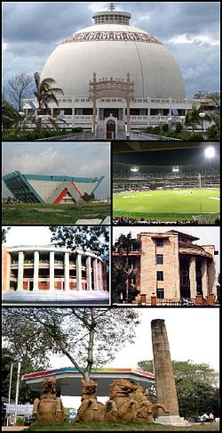
NAGPUR

Slide 2
About Nagpur
Nickname(s): The Orange City, Tiger Capital of India, Winter capital of Maharashtra
State: Maharashtra
Region: Vidarbha
District: Nagpur
Founded: 1702 AD
Founder: Raja Buland Shah
Government:
  Body: Nagpur Municipal Corporation
  Meyor: Anil Sole (BJP)
  Municipal Commissioner: Shyam D Wardhane
  Police Commissioner: Kaushal Pathak
Area of Metropolitan city: 217.65 sqkms
Population (2011): 2,405,421
Density: 11,000/sqkm
Official & Major language: Marathi
Rank in India: 13
RSS stronghold (Founded in 1925 by KB Hedgewar to create a Hindu nation)

Slide 3
East Nagpur
Kalamna is one of the largest wholesale markets for oranges and grains in Asia.
Mominpura popularly known as the Chandni Chowk of Nagpur. Small restaurants and hotels are open over night. Famous biryani delicacies can be enjoyed here at ML Canteen,Babbu, Bartania and many more eating joints. Hajj House is likely to be constructed here. Mayo hospital and Jama Masjid are part of Mominpura.
Itwari is the wholesale business center of Nagpur. Hardware, cloth, household, wedding saree market of central India. There is huge concentration of Muslim-Bohra community in this area, with their business, residence and religious places.

Slide 4
Central Nagpur
Mahal is the oldest part of Nagpur, and is noted for its relatively narrow streets and crowded residential quarters. The famous Bhonsale palace, residence of the Bhonsale kings, is situated in Mahal. There are many historic temples in Mahal area such as Kalyaneshwar Mandir, Pataleshwar Mandir and Aychit Mandir. There are many Historic Mosque such as Shahi masjid, pattharphod Masjid, Kala patthar masjid are sitiuated in this area. Shahi masjid Of Killa Area is the first Mosque of Nagpur City made by Raja Bakht Buland Shah. Mahal is also residence of Nitin Gadkari president of Bhartiya Janta Party. Mahal is also headquarters of RSS. Mahal is also known for its cloth market and old book market situated on Kelibagh road.
Sitabuldi (commonly referred to as 'buldi', pronounced 'burdi') is the main commercial part of the city. It contains numerous shops of all sizes and the largest wholesale vegetable market in Nagpur. Sitabuldi Main Road is one of the main shopping streets in the area. Also located in Sitabuldi is the Sitabuldi Fort. It is situated on an elevated area. Being under the control of the Indian Army, the fort is only open to the public on two occasions every year—August 15 (Independence Day) and January 26 (Republic Day). The longest flyover in Nagpur has its origin near Sitabuldi Fort and terminates at Rahate Colony Square, approximately 1.8 kilometers away.
Dhantoli is the best residential area in Nagpur.Locality is home to several business tycoons, corporate high rollers, professionals and artists .Example : Vikram Pandit of Citigroup, V.R.Manohar (Hotshot lawyer & former Advocate General of Maharashtra) and Shashank Manohar (Former BCCI president)

Slide 5
West Nagpur
Dharampeth, Shivajinagar, Gokulpeth, Gandhi Nagar, Ambazari Layout, Shankar Nagar, Bajaj Nagar, Abhyankar Nagar, Laxmi Nagar, Pratap Nagar, Khamla, Vivekanand Nagar, Ramdaspeth are residential areas in this region.
The Civil Lines contains most of the government offices and residences in Nagpur including the Bombay High Court bench and the Vidhan Bhavan. The area is noted for its greenery, roads and cleanliness.
Seminary Hills is home to educational institutes like SFS College, LAD, Nagpur veterinary college, Maharashtra Animal and Fishery Sciences University, KV, Center Point school and offices like Air Force, CGO Complex, TV Tower. For entertainment there is Joggers Park, Deer Park, Toy Train, swimming pools etc.
Sadar is a famous shopping place, close to Railway Station. Famous locations in Sadar include NIT Building, Karachiwala Mall, Kasturchand Park, SFS school, SFS Cathedral, All Saints Cathedral,IT Park, Anjuman Engineering College complex, Govt Polytechnic, Governor's House and Mangalwari Bazar and Mangalwari Complex - the hub of major coaching classes in Nagpur. Dinshaws, Tuli Hotel and many restaurants are here.

Slide 6
South Nagpur
Medical Square is a place near Government Medical College and Hospital which is a Govt. managed body concerning public health care.
Sakkardara square is a place famous for Sakkardara lake, Chhota tajbag, Budhawar Bazaar & colleges. Also it is famous for its delicacies such as Panipuri, Bhelpuri, Samosa. It also includes area such as Reshimbagh, Nandanvan, Hasanbagh.
Manewada, Besa, Narendra Nagar and Satyam City are suburbs with many new residential projects.
Rameshwari. It consist of many dalit wards like Vishwakarma Nagar, Chandramani Nagar,Kunjilal Peth, Nalanda Nagar' Bhagwan Nagar, Trisharan Chowk, Kanshi Nagar, Shatabdi Chowk, Ramabai Ambedkar Nagar, Jogi Nagar, Bhim Nagar, Babulkheda, Kukde Layout, Kaushalya Nagar etc.

Slide 7
Religions of Nagpur
Religions | Percentage
Hinduism | 66.0 %
Islam | 11.0 %
Buddhism | 20.0 %
Jainism | 1.5 %
Christianity | 1.0 %
Others | 0.5 %

Slide 8
Slums in Nagpur
Name of the Slum | Numbers of Slums
Laxmi Nagar | 32
Dharampeth | 50
Hanuman Nagar | 19
Dhantoli | 64
Nehru Nagar | 26
Gandhibagh | 38
Satranjipura | 54
Lakadganj | 54
Aasi Nagar | 64
Mangalwari | 47
New Panchsheel Nagar | 60
Panchsheel Nagar | 80
Bhim Nagar | 200

Slide 9
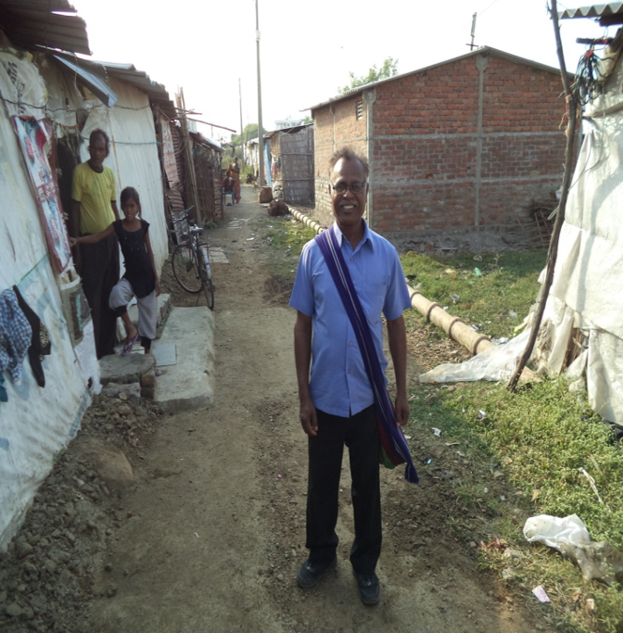
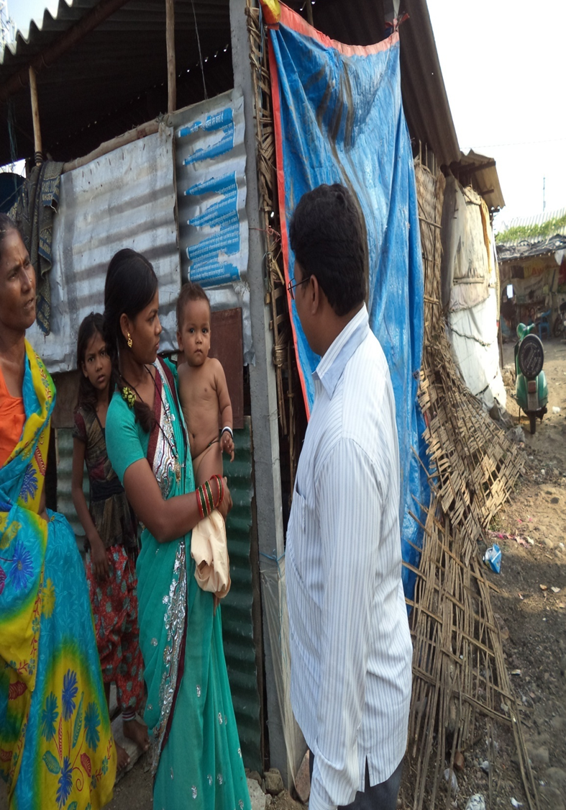
Students in the Slums

Slide 10
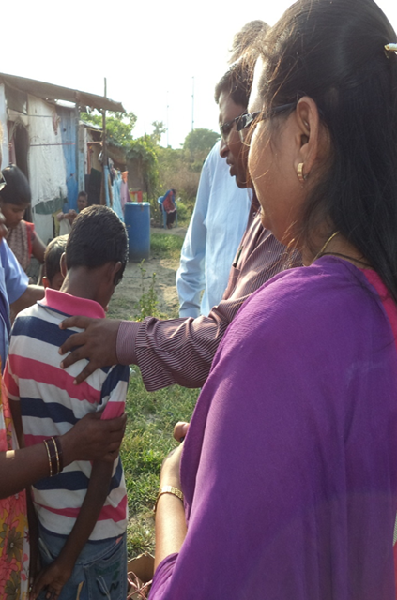
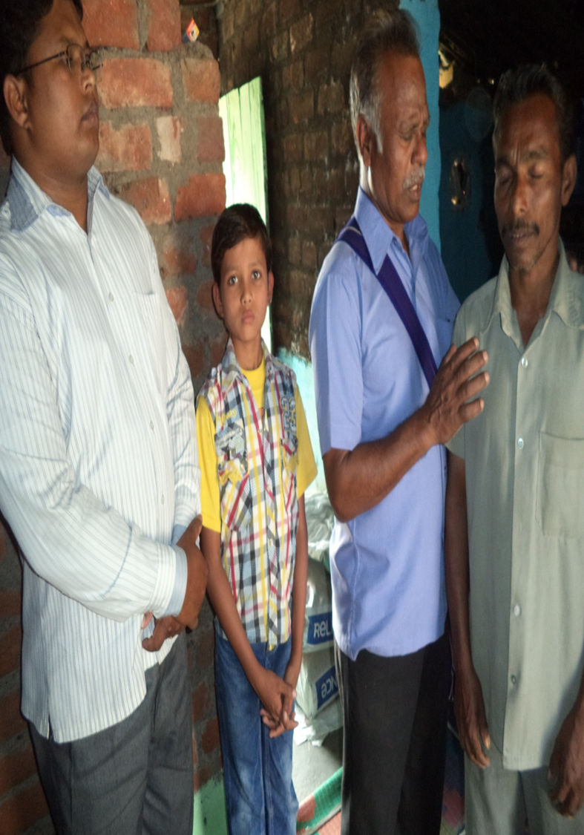
Students in the Slums

Slide 11
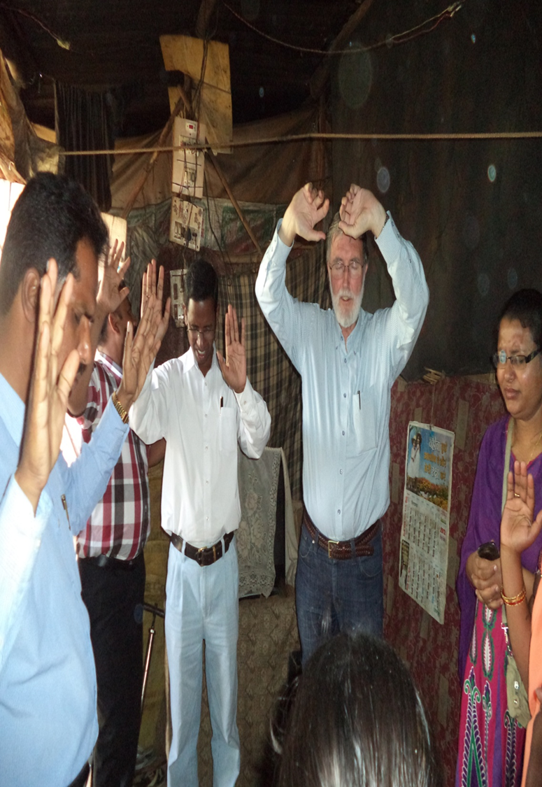
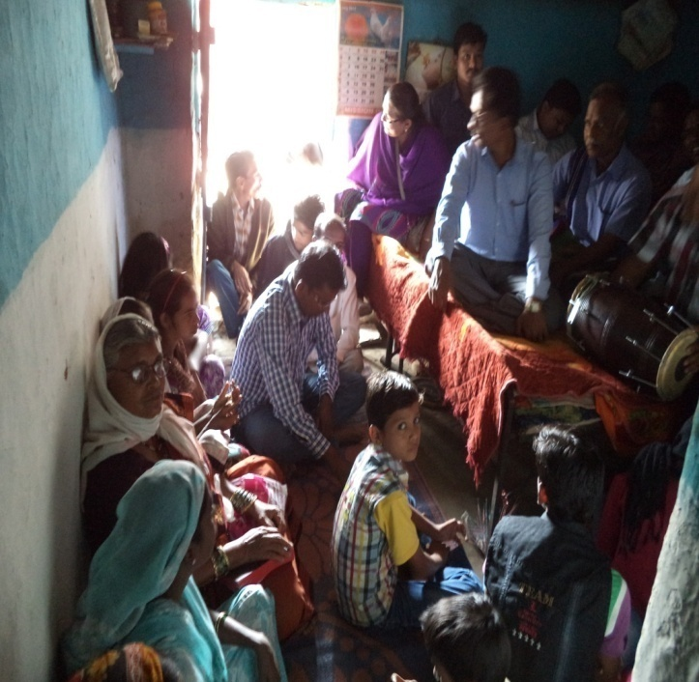
Worship in the Slums

Slide 12
Class on Community Economics
Dr. Viv Grigg with
MITS Faculty

